Slide 1
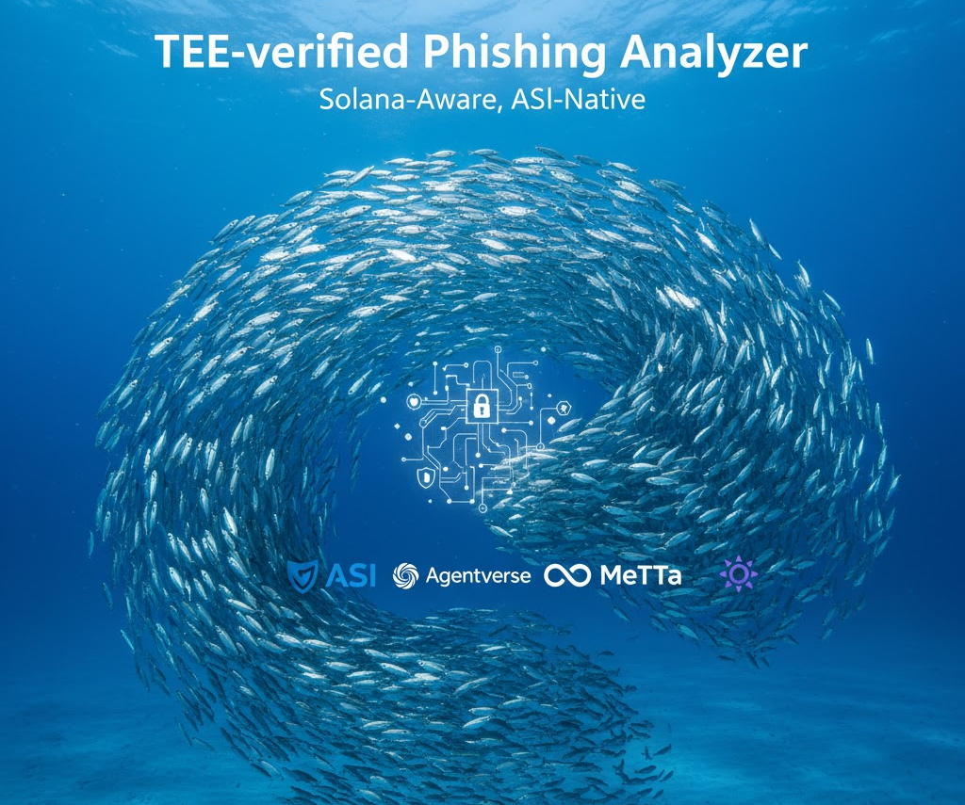
Phishnet

Slide 2
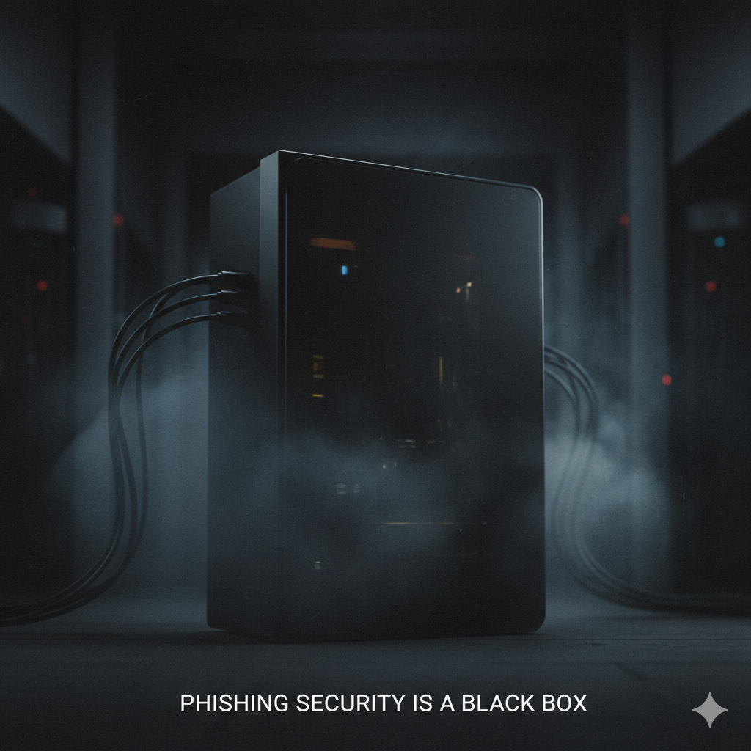
Phishing Security is a "Black Box
Existing tools are siloed: they handle Web2 (email) or Web3 (wallet drainers) , but rarely both.
Most tools are simple blacklists or signature databases. They don't provide severity scoring or explain why something is dangerous
Analysis is centralized. You can't verify the code or rules , creating a single point of trust.

Slide 3
An Explainable, Verifiable Security Oracle
Explainable: A unified risk model for Web2 & Web3. Each verdict is backed by explicit MeTTa rules, explaining why it's unsafe.
Verifiable: TEE Attestation (using AWS Nitro) cryptographically proves the analyser code and ruleset were not tampered with. A RefereeAgent validates this proof
Decentralised: Built with uAgents , discoverable on Agentverse , which log a tamper-evident report hash on Solana.

Slide 4
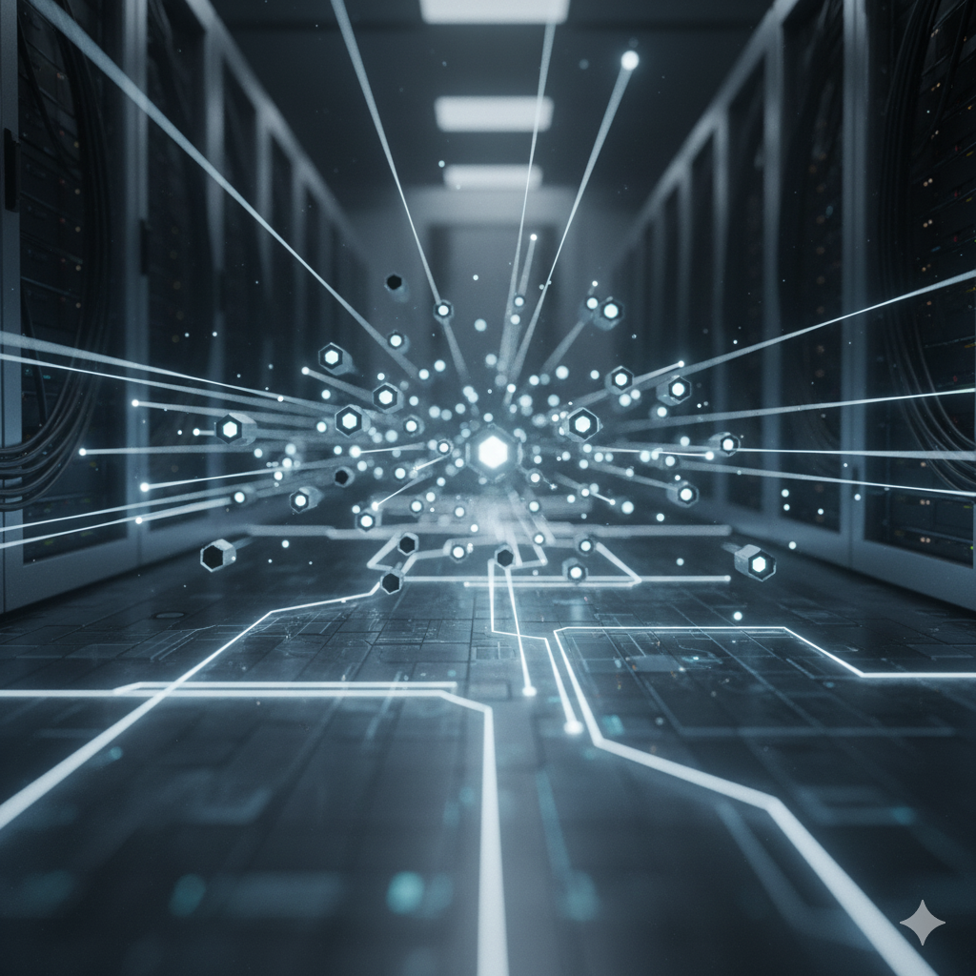
Composable Security Agents
1. IntakeAgent: Receives the artifact (URL, text, tx) via Chat Protocol.
2. AnalyzerAgent: Calls the Go service (running in its TEE) to get a cryptographically signed report.
3. RefereeAgent: Verifies the TEE attestation and signature to ensure the report is valid and tamper-proof.
4. OnchainAgent: Pushes the verified report hash to a Solana smart contract for a public, tamper-evident log.

Slide 5
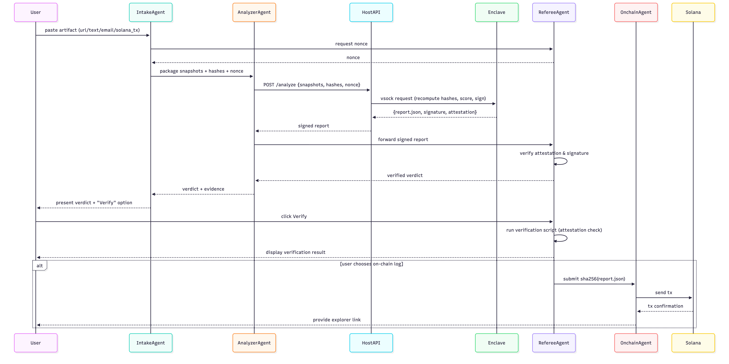
Anatomy of an Analysis: The Agent Interaction Flow

Slide 6
The Agent Interaction Flow
1. Intake: A user sends an artifact (like a URL or transaction) to the IntakeAgent via the Chat Protocol.
2. Nonce Request: The IntakeAgent asks the RefereeAgent for a unique nonce (a one-time-use number) to ensure the request is fresh.
3. Analysis & Attestation: The AnalyzerAgent receives the artifact and nonce, then calls the core Go service (running in its TEE). The service performs the analysis and creates a signed report that includes the TEE attestation.
4. Verification: This signed report is sent to the RefereeAgent, which validates the TEE attestation, the ruleset hash, and the nonce. This proves the analysis was done by the correct code and wasn't tampered with.
5. Verdict: Once verified, the IntakeAgent presents the final, trusted verdict (e.g., CRITICAL) and the evidence to the user.

Slide 7
Demo Walkthrough: Web2 Phishing
Input: A test client sends a malicious URL.
check url https://paypal.com.example.xyz/login?private_key=123
2. The IntakeAgent gets the request, the AnalyzerAgent generates a report, and the RefereeAgent verifies it as valid.
3. Output: The agent returns a clear, evidence-backed verdict.
Severity: HIGH
Verdict: unsafe
Evidence: {'url': 'https://paypal.com.example.xyz/login?private_key=123', 'metadata': {'scheme': 'https', 'domain': 'paypal.com.example.xyz', 'is_ip': False, 'suspicious_tld': True, 'subdomain_tricks': False, 'punycode': False, 'path_length': 6, 'query_keywords': ['private_key']}, 'alerts': [{'id': 'kw_private_key', 'description': 'Explicit request for private key (never legitimate)', 'severity': 'high'}, {'id': 'kw_login', 'description': 'Generic login/signin prompts used to phish credentials', 'severity': 'medium'}, {'id': 'kw_login', 'description': 'Generic login prompt often used in phishing URLs', 'severity': 'medium'}, {'id': 'suspicious_tld', 'description': 'Suspicious TLD detected: xyz', 'severity': 'medium'}, {'id': 'query_private_key', 'description': 'Suspicious query parameter: private_key', 'severity': 'high'}], 'verdict': 'unsafe', 'severity': 'high'}

Slide 8
Solana Phishing Verifying an On-Chain Transaction
INFO: [IntakeAgent]: Received chat from agent1qgrw2c0kvte8tphwy2wymgusegdsgsn9mk826hks5pmndhv3l22z6vergj8: {"artifact_hint": "solana_transaction", "signature": "bad_signature_123", "from_address": "5Jfb3n8eW4JyQrKJktMNBFXnC1zx2YHjRSkzRrTT5QHh", "to_address": "ESSfP3aAcW6Z59ozut9Jkqy9btaX5YTHt25b3Vhs2hsf", "amount": 250.0, "token": "SOL", "timestamp": "2024-05-01T12:30:00Z", "block_height": 250123456}
INFO: [IntakeAgent]: Created ticket 6e4e1040-a7a2-4ae6-a0c6-9020ffd5f8b0 for analysis
INFO: [AnalyzerAgent]: Received analysis request for ticket 6e4e1040-a7a2-4ae6-a0c6-9020ffd5f8b0
INFO: [AnalyzerAgent]: Routing artifact type solana_transaction for analysis
INFO: [AnalyzerAgent]: Analysis result verdict: unsafe
INFO: [AnalyzerAgent]: Attestation source: solana_analyzer
Severity: CRITICAL
Verdict: unsafe
Evidence: {'transaction': {'signature': 'bad_signature_123', 'from_address': '5Jfb3n8eW4JyQrKJktMNBFXnC1zx2YHjRSkzRrTT5QHh', 'to_address': 'ESSfP3aAcW6Z59ozut9Jkqy9btaX5YTHt25b3Vhs2hsf', 'amount': 250.0, 'token': 'SOL', 'timestamp': '2024-05-01T12:30:00Z', 'block_height': 250123456}, 'alerts': [{'id': 'malicious_from_5Jfb3n8eW4JyQrKJktMNBFXnC1zx2YHjRSkzRrTT5QHh', 'description': 'Malicious developer wallet detected in previous incidents', 'severity': 'critical'}, {'id': 'malicious_to_ESSfP3aAcW6Z59ozut9Jkqy9btaX5YTHt25b3Vhs2hsf', 'description': 'Malicious developer wallet #2', 'severity': 'critical'}], 'verdict': 'unsafe', 'severity': 'critical'}

Slide 9
Completing the process, logging to Solana
"txSignature": "BM3caSxB2rA9whhxeBMZ2RCPjsNyYemDAdGUoE4PHSQ77nmLPufYVQdSACboxwN9dNn3n7nKcAjtUkmwTmv3jRN",
"payer": "E5GAPTRyqx4pHHNFamJeU4GQFw3MqHpGhhwqgckAnRxD",
"memo": {
"v": 1,
"scan_id": "scan-1761830374",
"verdict": 2,
"url_sha256": "c4e6fc1499eb680f1d937c0cde80436ddd287d891b059afc28f837c094460fc5",
"att_sha256": "28cf38bc5041f1a5dfd21be0f0fe089820f78520fe843d8117b2c58316905b36",
"cid": "",
"ts": 1761830374
}
}

Slide 10
From "Black Box" to Verifiable Trust
Solves Central Trust: Users don't need to trust us. They can trust the TEE's cryptography.
The RefereeAgent proves the analysis is honest and tamper-proof.
Solves Composability: Agents are like security "microservices". New agents for other chains (like EVM) or new rules can be added dynamically without breaking the system.
Creates an Audit Trail:
Every verdict can be publicly verified against the immutable report hash logged on Solana.
Metta Knowledge Base
Fetcher agents adds to our rules, and agents share their experience

Slide 11
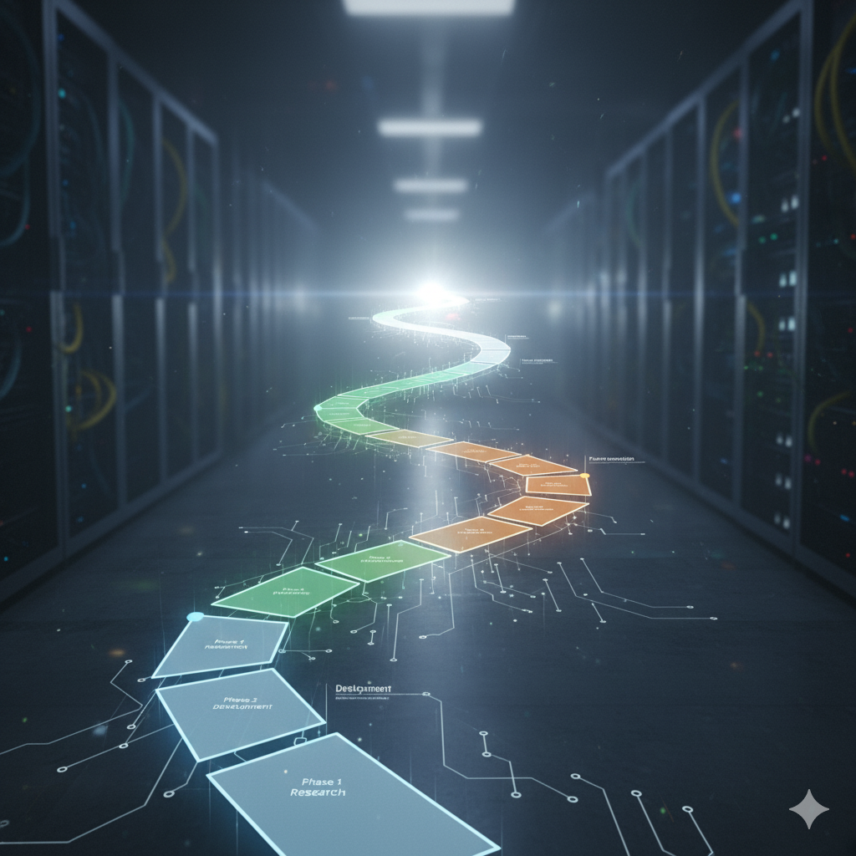
Roadmap
Phase 2 : Integrate as a "security oracle" with wallet plug-ins and DAO/Discord bots , moving to a Security-as-a-Service model.
Phase 3 : Launch a collaborative network where multiple teams run analyzer agents.
Phase 4: Create an "Open Threat Graph" —a public knowledge graph of verified phishing indicators maintained by autonomous agents.

Slide 12
Explainable, verifiable, Solana-aware security.
Demo: demo.phishnet.xyz
Website: phishnet.xyz
Key Tech: ASI · Agentverse · MeTTa · Solana · TEE

